Slide 1
Using fantasy stats to predict NFL win percentage
Michael Brown
Zack Soden
DATA 606 - Spring 2022

Slide 2
Questions
We aim to answer:
Do teams with players who accumulate a lot of fantasy points achieve more wins than teams that do not?
Is there a correlation between fantasy points scored and team wins?
Does a particular player position have a stronger correlation to wins?
Use historical data to train a model that predicts team wins based on fantasy points
Compare projected team win results to actual results

Slide 3
Assumptions
Teams with talented skill position players will have higher fantasy points based off yards and touchdowns. In general, scoring more TD’s should lead to more wins
Fantasy football often comes down to a player’s usage (rushes, catches, pass attempts, etc.) which can fluctuate depending on the flow of the game
Quarterbacks on teams that are losing by 7 or less points in the 4th quarter have double the amount of pass attempts as those on teams who are winning by 7 or less
More pass attempts means more yards and touchdowns (positive gain in fantasy points) but also more interceptions ( negative points)
Player injuries, weather, “momentum” can also affect usage
Notes:
https://dknation.draftkings.com/nfl/2020/6/26/21309173/predicting-game-flow-in-the-nfl

Slide 4
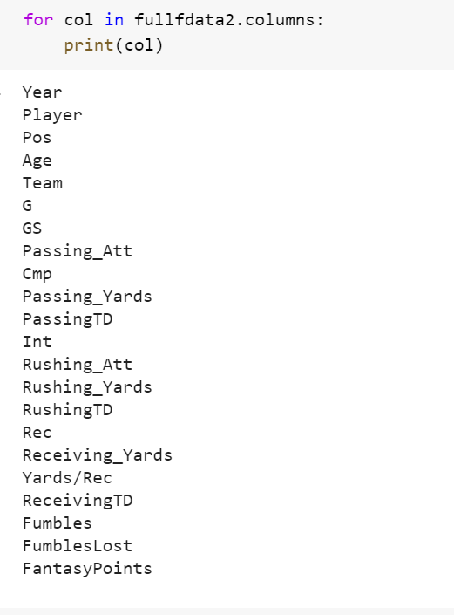
Data
Fantasy data from NFL seasons 1970-2019
Merged 50 separate .csv files into a single dataframe
After cleansing: 23,144 rows × 22 columns
Points are yearly totals
Having team name and position values can allows for more detailed analysis
https://www.fantasyfootballdatapros.com/csv_files
Notes:
Data:
Weekly and Yearly Fantasy point datasets available through 2019 from: https://www.fantasyfootballdatapros.com/csv_files

Slide 5
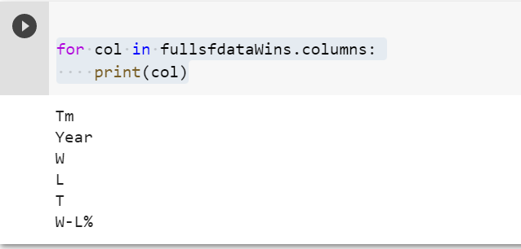
Data (cont.)
NFL Team standings from NFL seasons 1970-2019
Two .xlsx files from each season (one for each conference)
Merged 100 files into a single dataframe
After cleansing: 1477 rows × 6 columns
1970 NFL Standings & Team Stats | Pro-Football-Reference.com
Both AFC and NFC Standings tables

Slide 6
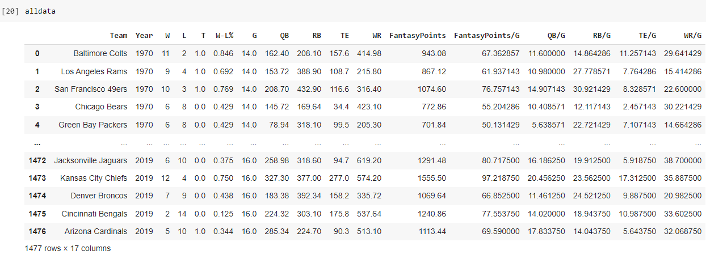
Exploratory Analysis
Finalized Data Set
Merged relevant columns from other data sets
Added columns that show points by position and averages points per game
1477 rows x 17 columns

Slide 7
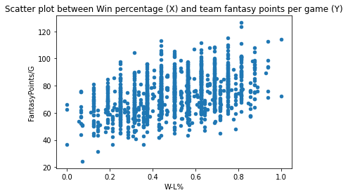
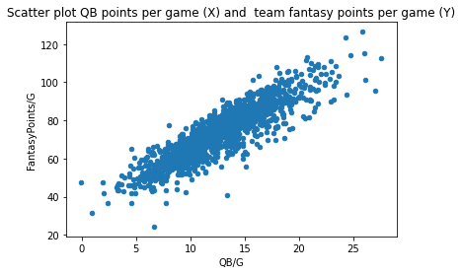
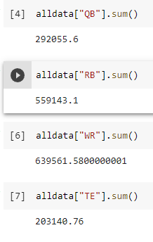
Exploratory Analysis
So far, we are seeing a correlation between points and win percentage
QB and WR points contribute most to total points scored
QB and RB points contribute most to win percentage
WR and RB have the highest percentage of total team points

Slide 8
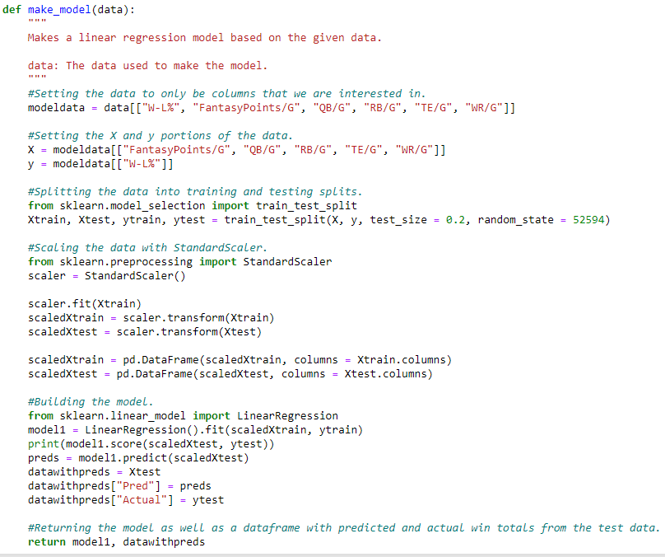
Building our model
Created a callable function that allowed us to create subsets of the data based on how many players from each position we wanted to include
Includes 1 QB, 2 RB, 2 TE, 3 WR per team by default.
To handle rookies, we had the option of using the positional mean score, the minimum, or the maximum, as well as ignoring them entirely.
Created a callable function to build models with the above data, and shows predicted and actual win % on test data

Slide 9
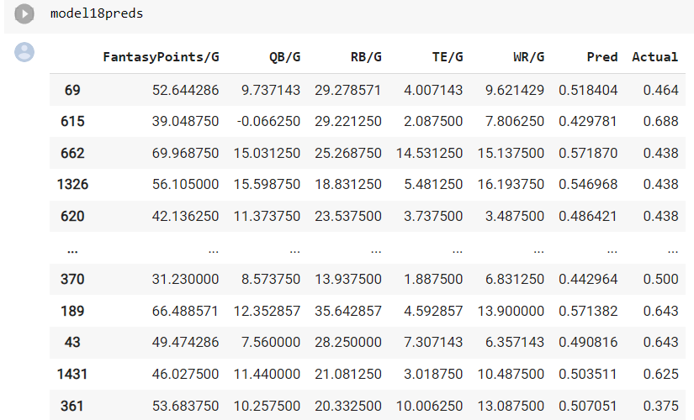
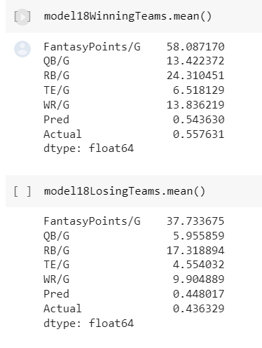
Model Results
We tried a few different combinations of handling rookies and varying numbers of players per position.
Our most accurate model had a score of 10.8% using 1 QB, 1 WR, 1 TE, and 4 RB. It also used the positional minimum score for rookies

Slide 10
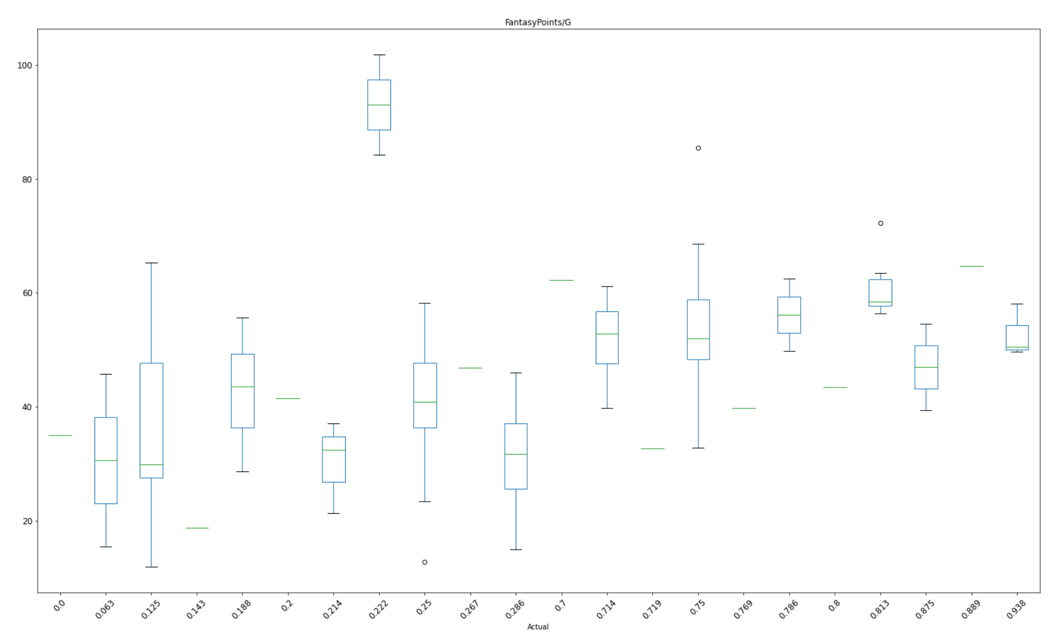
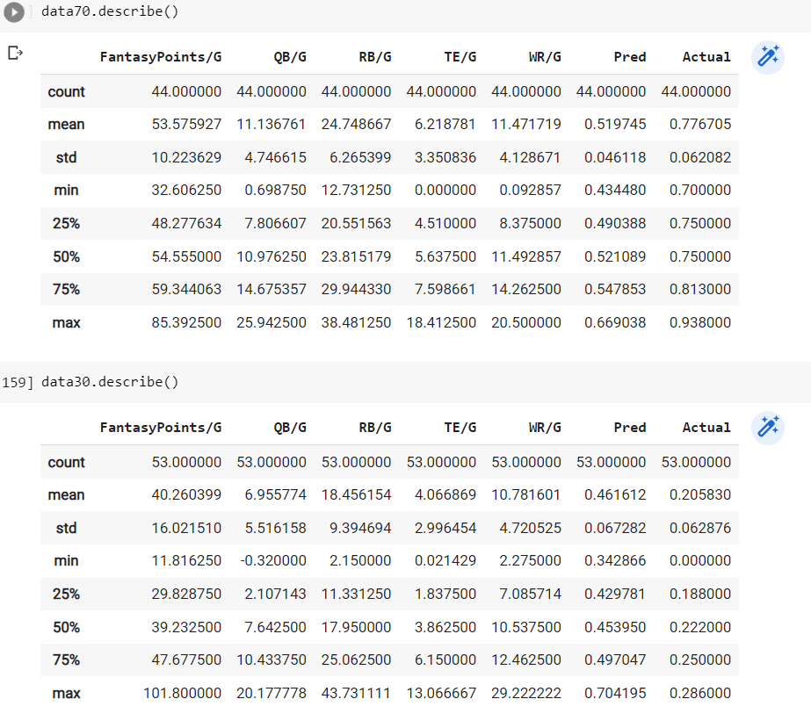
Model Analysis (cont.)

Slide 11
Conclusion
Lack of defense and kicker data might be more impactful than we originally assumed.
The model heavily focuses on RB over the other positions, because it is the most stable.
Still no great way to handle players who played in year X but not year X -1.
There are several extreme outliers in terms of predicted versus actual win percentage

Slide 12
Conclusion
Do teams with players who accumulate a lot of fantasy points achieve more wins than teams that do not?
Yes. Our model showed that successful teams score on average about 32.5% more fantasy points that unsuccessful teams
Is there a correlation between fantasy points scored and team wins?
Yes, but the correlation is fairly weak
Does a particular player position have a stronger correlation to wins?
Yes, our model reinforces that RBs contribute the most to team wins. The basic idea is that RB performance is more predictable and has less variance than WR/TE who depend on the QB

Slide 13
References
Becker, A., & Sun, X. A. (2016). An analytical approach for fantasy football draft and lineup management. Journal of Quantitative Analysis in Sports, 12(1). https://doi.org/10.1515/jqas-2013-0009
Murphy, C. (2020). ESPN 2019 Stats and 2020 NFL Fantasy Projections. Kaggle.com; Kaggle. https://www.kaggle.com/mur418/espn-2019-stats-and-2020-nfl-fantasy-projections
Predicting Game Flow in the NFL. (2020, June 26). DraftKings Nation; Vox Media, LLC. https://dknation.draftkings.com/nfl/2020/6/26/21309173/predicting-game-flow-in-the-nfl
Robinson, C. (2020). The Prediction of Fantasy Football. Louisiana Tech - Mathematics Senior Capstone Papers, 12(1). https://digitalcommons.latech.edu/mathematics-senior-capstone-papers/20

